Slide 1
Database Design, Data Modelling and Introduction to MySQL

Slide 2
Data Warehouse
A data warehouse is the central repository of data of the entire enterprise.
A data warehouse is conceptually similar to a warehouse.
A data warehouse is characterised by the following:
- Subject oriented: Built for a specific purpose
- Integrated: Collated from multiple sources into one form
- Non-volatile: Data does not change over time
- Time variant: Capable of capturing information over time
Warehouse | Data Warehouse
1. It is used by a retail company to store all its goods. | 1. It is used by a company to store all its data in databases.
2. Goods are stored such that their retrieval and management is easy. | 2. Data is stored such that its retrieval and management is easy.

Slide 3
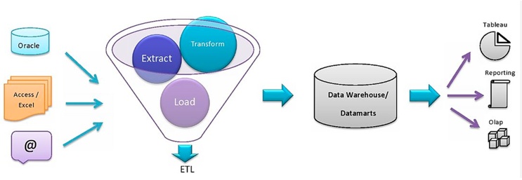
Flow of Data in an Organisation

Slide 4
Data is captured from multiple sources and stored in Excel files or in databases, such as Oracle.
The Extract, Transform, Load (ETL) process is performed on the captured data in the following manner:
Extract: Extracting the information from the data sources
Transform: Transforming the values to the required format, such as converting rupees to dollars
Load: Loading the data into a central repository, which is none other than a data warehouse
The stored data is either connected to Online Analytical Processing (OLAP) for further processing or used for creating reports in tools, such as Tableau or PowerBI.

Slide 5
Dimensional Model
A dimension model is a database structure technique and is used to optimize the database for the fast retrieval of data.
The dimensional model contains two entities:
Facts
Dimensions
Facts are the numerical data and dimensions are the metadata (that is, data explaining some other data) attached to the fact variables. Both facts and dimensions are equally important for generating actionable insights from a data set.

Slide 6
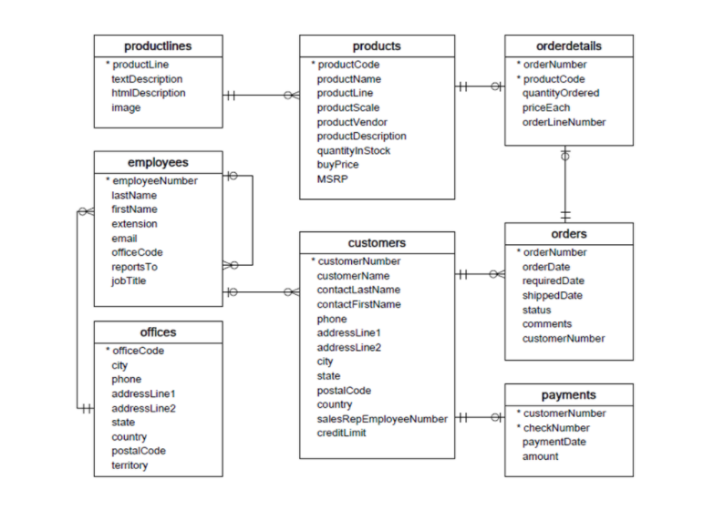
Entity Relationship Diagram
An Entity Relationship Diagram (ERD) is a representation of the tables in a database.
It gives us an idea of how different entities are connected.
ERDs are extremely useful to get an overall idea of a database in very less time.
Example:

Slide 7
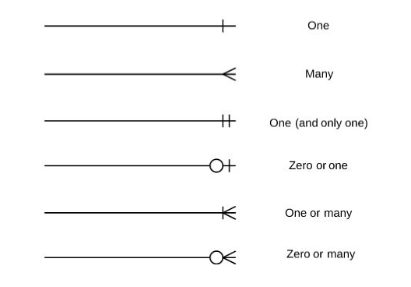
Notation in an ERD:
Fields marked with a star are the primary keys for each table.
A line connecting two tables indicates that a relationship exists between them.
A line connecting a table to itself indicates that the table references itself.
Types of cardinalities that can exist in a relationship:

Slide 8
There are four types of relationships that exist in an ERD:
One to One: One to one type of relationship exists, when a single instance of an entity is related to only a single instance of another entity.
One to Many: One to many type of relationship exists, when a single instance of an entity is related to more than one instance of another entity.
Many to One: Many to one type of relationship exists, when more than one instance of an entity is related to only one instance of another entity.
Many to Many: Many to many type of relationship exists, when more than one instance of an entity is related to more than one instance of another entity.

Slide 9
Schemas
A schema is an outline of the entire data model which shows how different data sets are connected and how the different attributes of each data set are used for the database design.
STAR SCHEMA:
A star schema is a type of schema design that has one fact table connected to multiple dimension tables.
Some of the advantages of star schemas are as follows:
Easy to understand
Easy to implement
Efficient in terms of querying because a maximum of only one join is required

Slide 10
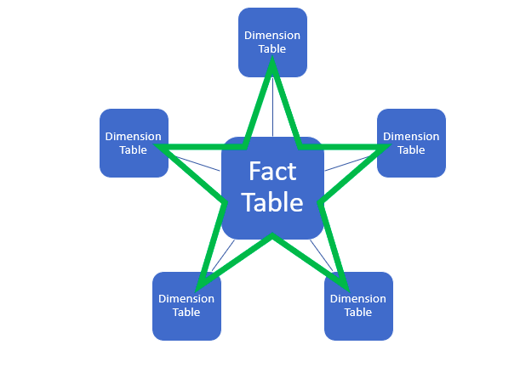

Slide 11
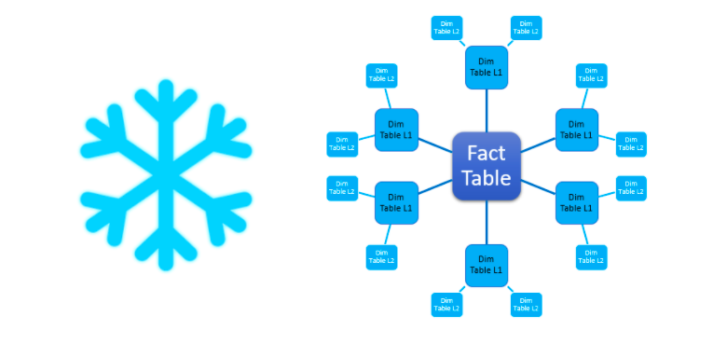
SNOWFLAKE SCHEMA:
A snowflake schema is called so because the dimension tables surrounding the fact table can branch off into more dimension tables.
Snowflake schemas are particularly useful when it becomes difficult to manage the size of the dimensional tables.
Snowflake schemas are efficient in terms of data storage.

Slide 12
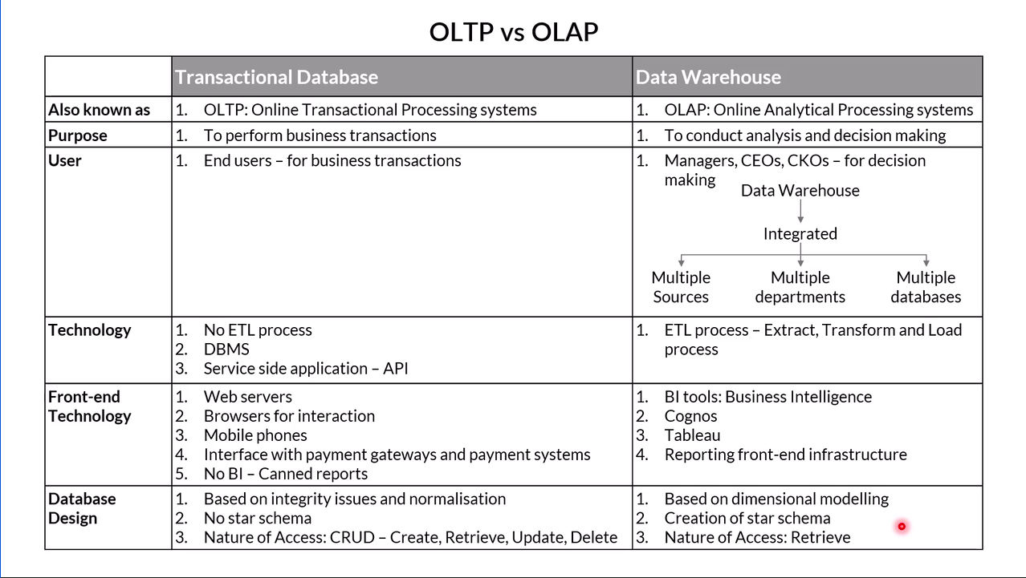
OLAP vs OLTP

Slide 13
Entity Constraints
Constraints are rules used to restrict the values that can be stored in the columns of a database. This ensures data integrity, which is nothing but the accuracy and consistency of the data stored in the database.
Entity constraints are of the following different types:
Unique: Used for columns that need unique values.
Eg: Employee IDs
Null: Determines the columns that can have null values.
Eg: An employee may not need to specify their location and therefore the location column can have a null value.
Primary Key: Determines the column that uniquely identifies a table.

Slide 14
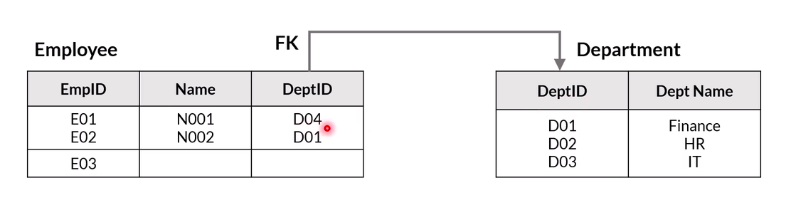
Referential Constraints
These are used to restrict the values that are taken by a column in one table based on the values that exist in another table.
According to this rule, the value that appears as a foreign key in a table is valid only if it also appears as a primary key in the table to which it refers.
A given table has only one primary key but it can have multiple foreign keys. Before you assign a column as a foreign key, you need to ensure that the primary key column of the table that it refers to is present and it does not have null or duplicate values.
Eg:

Slide 15
Semantic Constraints
Semantic constraints impose additional restrictions on the values in a column. Using a semantic constraint ensures that we do not get incorrect data for any row in the database.
Eg: A row with an Indian phone number not having 10 digits after the country code would not be allowed to enter the database.

Slide 16
Data Modelling
Data modelling is the first step in the analytics journey of an organisation. Before you begin with the analysis of data, you need to ensure that it is stored in a data warehouse in the correct structure, format and shape.
It can be compared to making a floor plan for your house i.e, lay foundation.
You need to first finalise the different tables and their relationships before you actually start creating the model. Once created, it is difficult to alter the structure of the model, as the relationships have already been defined. In essence, it is advised to finalise the design before implementation.

Slide 17
Applications of Data Modelling
Data modelling is essential in almost every industry. A thorough analysis of well-organised data can lead you to identify trends that you never knew existed, and act on them.
Social media:
Your user profile
The pages/accounts that you visit
The kind of interactions that you have with your friends
The similarities and differences between what you like and what your friends like
Streaming platforms:
The categories/types of videos that you watch
Whether you discontinue watching particular videos and if so, at what points of time
Whether you skip ads or watch certain ads

Slide 18
Airline industry:
Ticket-booking information of travellers, including their places of arrival and departure
Time periods during which customers do more bookings
Time periods during which certain routes have a higher demand
Mobile applications:
Your navigation in the app: The pages that you visit, the time you spend on those pages and your interaction with them
Frequently updated data: Saved addresses
Banking sector:
Your transaction history
Your user profile
Preferred products: Netbanking services, branch visits or phone banking services

Slide 19
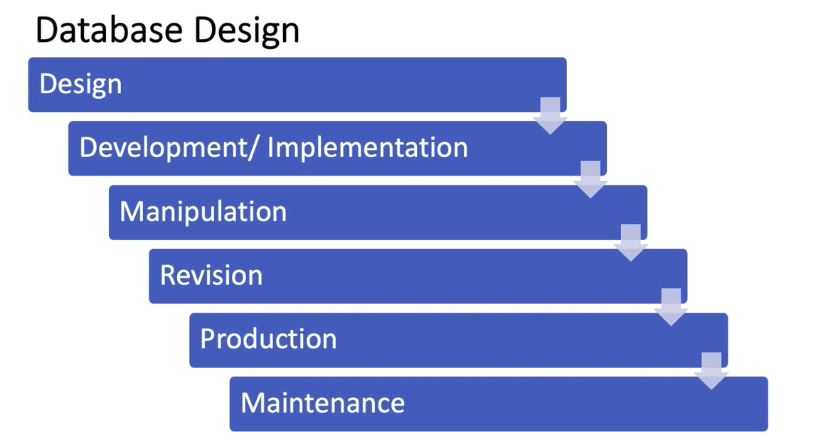
Database Design-Creation-Manipulation Cycle

Slide 20
Design: Create an ERD for the given business requirement.
Development/Implementation: Create the required structure – tables and their relationships – in a database design tool, such as MySQL Workbench.
Manipulation: Insert the records into the tables created.
Revision: Test and refine the structure according to any changes in the business requirement.
Production: Deploy the database into a production environment and automate the entire cycle so that the entire data gets updated on a day-to-day basis.
Maintenance: Update the created schema according to the changes in the structure (if any).

Slide 21
Relational Schemas
The major aspect of a relational schema is relationships.
All the tables within it are linked to each other with one or more relationships.
We need such a schema to optimise storage space or querying or both.
It helps us understand how to combine data from multiple tables and get the required output.
Advantages | Disadvantages
1. Easy to structure data | 1. Rigid, restricts flexibility
2. Efficient querying as optimisations, such as indexing are possible | 2. Not horizontally scalable
3. Easy to navigate and explore data | 3. Minimal/No support on semi-structured data, such as JSON objects and XML data types
4. Easy to define relationships between data points | NA

Slide 22
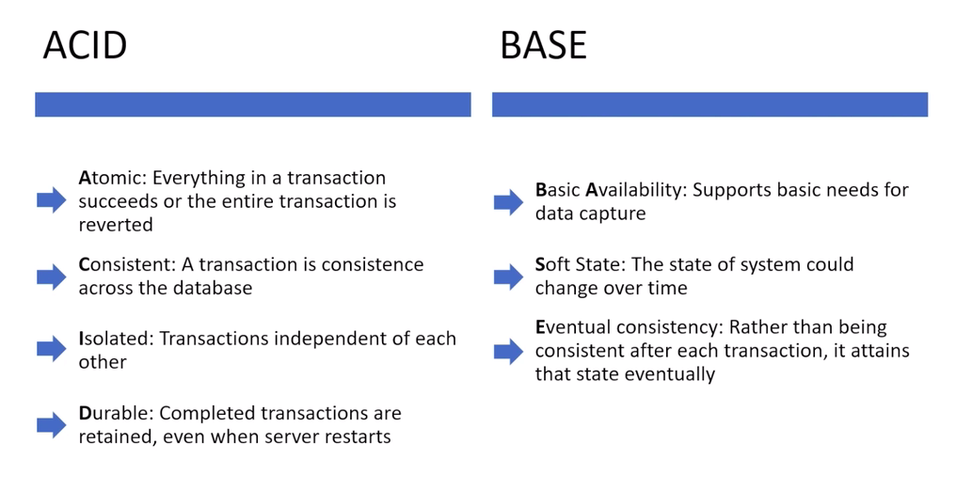
Relational vs Non-Relational Schemas
Non-relational schemas have certain advantages over relational schemas such as:
No requirement for setting up relationships between multiple tables
Highly flexible
Highly scalable
ACID VS BASE TEST:
Note: In essence, non-relational schemas are built for huge data-capturing requirements, whereas relational schemas are preferred for capturing transactions.

Slide 23
SQL - Structured Query Language
SQL stands for Structured Query Language. In some applications, it is also referred to as DSL, or Domain Specific Language. SQL is used for managing and manipulating data held in a relational database management system (RDBMS).
SQL helps you to:
Create data,
Manipulate data,
Delete data, and
Share data
Why should you learn SQL?
SQL is language-agnostic, which makes it a language that can be easily learnt and comprehended.
It is also supported by all the modern database systems such as Oracle, MySQL, SQL Server and so on.

Slide 24
RDBMS - Relational Database Management
RDBMS helps to store your data while preserving the relationships within the data.
It is a Database Management System that stores data in the form of tables, where each table is related to the other tables in the database.
This kind of model follows a relational model and hence, it is known as a relational database management system.
Common industrial applications of RDBMS :
The banking sector
E-commerce websites
Social networking sites

Slide 25
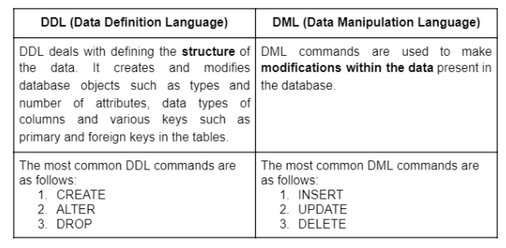
SQL Commands
SQL commands are mainly divided into two subcategories:
DDL (Data Definition Language)
DML (Data Manipulation Language)

Slide 26
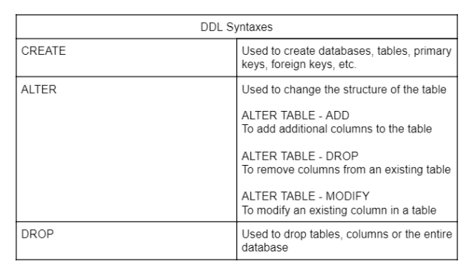
DDL Statements

Slide 27
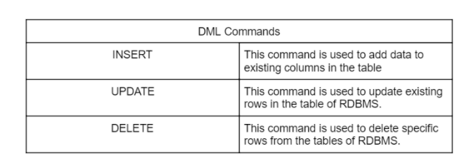
DML Statements

Slide 28
Basic SQL Commands
SELECT: Used to read the data
WHERE: Used as a conditional statement to filter out data
OPERATORS: Some examples of operators that can be used along with the WHERE clause are ‘OR’, ‘AND’, ‘IN’, ‘BETWEEN’.
LIKE: It is a logical operator that checks whether a string contains a specified pattern or not. The following two wildcards are used to specify the pattern:
‘%’ allows you to check with a string of any length.
‘_’ allows you to check with a single character.
GROUP BY: Groups data that have the same values based on the specified condition
HAVING: Used as a WHERE clause in conjunction with grouping statements
ORDER: Used to sort the data

Slide 29
Aggregation, Grouping and Inbuilt functions
Aggregation functions:
COUNT(): Counts the total number of records specified by the given condition
SUM(): Returns the sum of all the non-NULL values
AVG(): Returns the average of all the non-NULL values
MIN(): Returns the minimum of the specified values (NULL is not included)
MAX(): Returns the maximum of the specified values (NULL is not included)
Common string functions: LOWER, UPPER, SUBSTRING, SUBSTRING_INDEX, LENGTH.
Common date-time functions: CURTIME, MONTH, YEAR, DAYNAME.

Slide 30
Regular Expressions
A regular expression is a pattern matching operation available in MySQL with the help of REGEXP operator. It is case-insensitive and provides powerful and flexible pattern match capabilities. It also supports a number of metacharacters giving more control while performing pattern matching.
Nested query
A nested query is a query within another query. The inner query is known as the subquery; it performs an operation, the output of which is used by the main query to perform additional operations.

Slide 31
Views
A view is a virtual table created as a result of operations on a single table or multiple tables.
A view can be treated like any other table and can be further updated or deleted.
When you create a view, there is no separate storage layer for storing this table. One major advantage of creating a view is data security.
Eg: Suppose you have confidential data and you need to make specific columns available to a user who is denied access to the rest of the data. In such cases, views can be used to extract the specific data, which is then shared with the user while keeping the main table hidden. As a result, the end-user can only see the view.

Slide 32
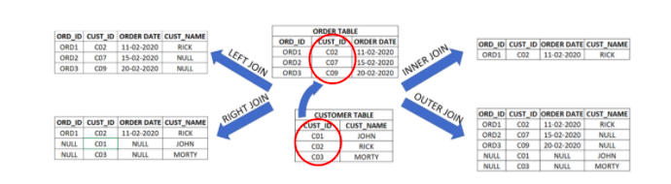
SQL Joins
The ‘Join’ keyword is used to join two or more tables by matching the columns of one table to the columns of another table.

Slide 33
SQL Joins
Inner Join: Combines the rows of two tables that have a matching value or satisfy a given condition.
Outer Join: Combines all the rows of two tables regardless of whether matching values exist. In case the value in one column does not have any corresponding matching value in another table, the records will be returned in the table with NULL values.
Left Join: Preserves the rows of the Left table, while attaching the rows of the Right table whose values in the matching column exist in the corresponding column of the Left table.
Right Join: Preserves the rows of the Right table, while attaching the rows of the Left table whose values in the matching column exist in the corresponding column of the Right table.
Cross Join: Returns all the possible combinations of joining the rows of one table with those of the other table along the matching column.

Slide 34
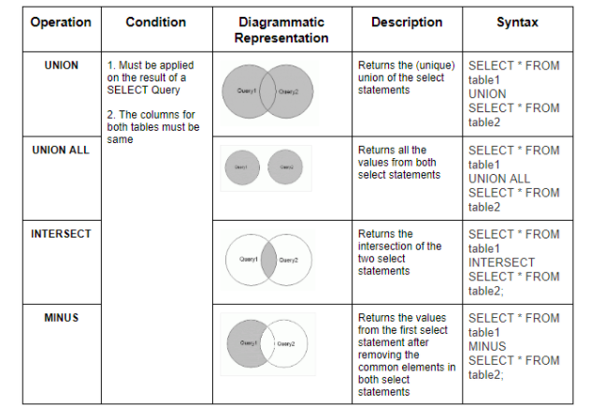
SQL-based Set Operations
The ‘Join’ keyword is used to join two or more tables by matching the columns of one table to the columns of another table.

Slide 35
Any Queries?

